Slide 1
Transcranial Direct Current Stimulation
BHV tDCS Badge Workshop

Slide 2
Who are we?
Security professionals that happen to be biohacking enthusiasts.
Hands-dirty seekers
We have high regard for objectivity, data driven conclusions, AND exploratory spirit
** This is our own independent research and POV and doesn't represent the views of our employers **
WE ARE NOT DOCTORS
Jennifer Szkatulski
@razzies
Darren Lawless
@dlaw

Slide 3
Workshop Overview
What is tDCS?
Why tDCS?
Electrode Placement
Common Montages
Device Handout
Electrode Construction
Hands on Lab

Slide 4

Pop Quiz
Notes:
You have one minute to memorize as many of the following words as possible

Slide 5
How Many of These Words Can You Remember in One Minute?
avenue | businessman | plain
pink | origin | connection
bridge | servant | success
suggestion | captain | birth
mist | surface | discipline
http://www.quantified-mind.com/
Notes:
60 seconds

Slide 6
Write Them Down
Notes:
2 minutes to write

Slide 7
How Did You Do?
avenue | businessman | plain
pink | origin | connection
bridge | servant | success
suggestion | captain | birth
mist | surface | discipline
Notes:
Baseline

Slide 8
Disclaimer
The tDCS device provided in this workshop is not intended as a medical device and is not approved by the FDA. The user accepts all risk associated with the advice, guidance, claims, and references provided within this presentation.
By accepting this tDCS device, you are accepting all risk associated with its ownership and usage.
Children, elderly, and people with history of epilepsy, stroke, or implants should consider avoiding DIY tDCS.
Please consult your physician before engaging in DIY tDCS

Slide 9
What is tDCS
Overview and History
“a form of neuromodulation that uses constant, low direct current delivered via electrodes on the head.”
By applying voltage to specific neuronal areas and pathways, we can amplify the strength of those connections, thereby increasing (or decreasing) our synaptic amplitude to craft a specific desired outcome.
https://medium.com/@vagabondbanana/what-is-tdcs-e29ff7288a02
Notes:
40 AD when Scribonius Largus (Roman Emperor Tiberius Claudius Nero Caesar’s personal physician) claimed that he could relieve headaches by placing a live Torpedo Fish (an electric ray) over the scalp of a patient. For nearly 10 centuries, this form of fish electricity was used to perform rudimentary tDCS

Slide 10
Why tDCS?
Used in the medical community as well as the DIY community
Parkinson’s
ADHD
Fibromyalgia
Depression
Cognitive Enhancement
Anxiety
Traumatic Brain Injury (TBI)
Stroke
Notes:
. . . There is also an acceleration of commercial neurostimulation device coming onto the market

Slide 11
Safety
tDCS is not approved by the FDA
“Transcranial devices are not playthings” (Bikson, Bestmann, & Edwards 2013)
External use only
9V battery only
DON’T BE A DUMBASS
Side effects
Phosphenes
Irritation
Tingling or itching
Metalic taste
https://www.nature.com/articles/501167b
Notes:
Keep the battery fresh
Components on this device are all exposed, DIY-grade. Discard or repair when signs of wear or malfunction occur.

Slide 12
Overview
Anode vs Cathode
Anodal stimulation acts to excite neuronal activity
Cathodal stimulation inhibits or reduces neuronal activity
Electrodes
Size
Placement (montages)
Quality comparison
https://medium.com/@vagabondbanana/is-diy-as-good-as-clinical-commercial-when-it-comes-to-tdcs-electrodes-1fc82fab66eb

Slide 13
Electrode Placement
10-20 System
Internationally recognized way to map out specific points on the scalp for electrode placement
In tDCS, we associate these points/regions with activity areas (based on research)
We are going to learn the basics of this system, but further research may be required

Slide 14
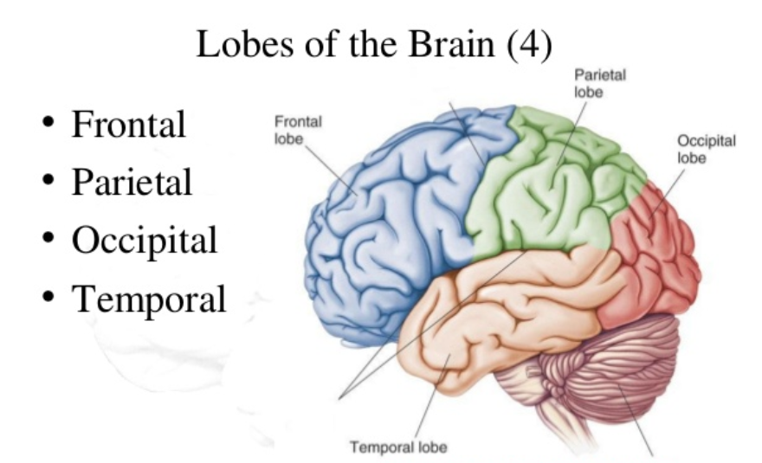
https://www.slideshare.net/veragirllegaspiaquino/brain-cortical-regions-and-functions
Notes:
Referred to as F, P, O, and T
Also Note (C) to indicate Center location
Midline (from front to back)
The frontal lobe is important for cognitive functions and control of voluntary movement or activity. The parietal lobe processes information about temperature, taste, touch and movement, while the occipital lobe is primarily responsible for vision. The temporal lobe processes memories, integrating them with sensations of taste, sound, sight and touch.

Slide 15
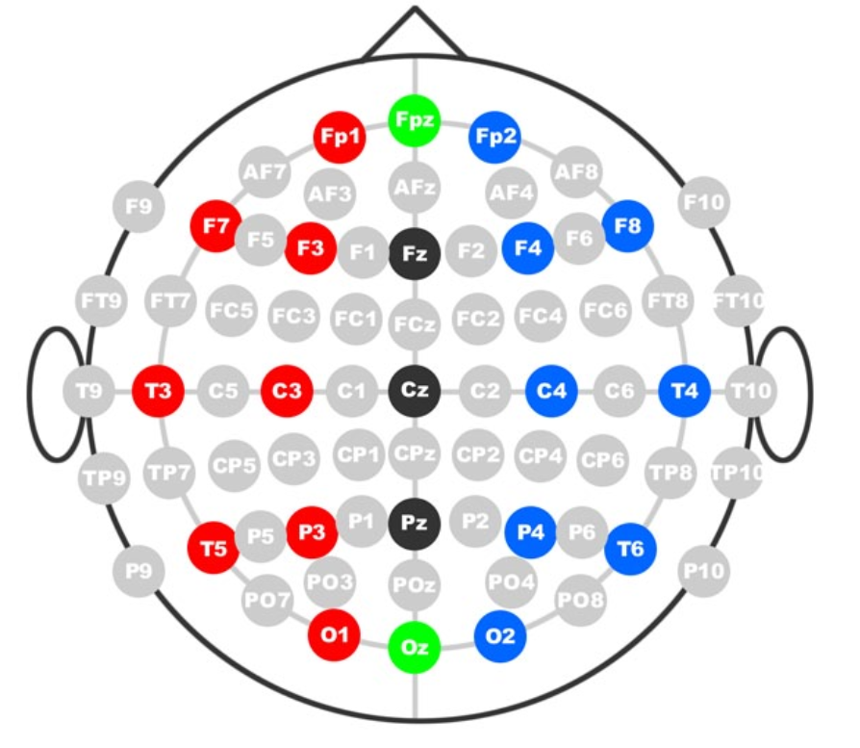
Mapped Scalp Using the 10-20 System
Notes:
F, P, O, T
Odd numbers on the left, even on the right

Slide 16
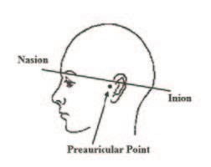
Important Points on the Skull
Nasion
Inion
Left preauricular point
Right preauricular point
experimenter_instructions-2017-02-23T08_02_51.303000.pdf

Slide 17
Mapped Scalp Using the 10-20 System
Tailored to each individual
Each point (or group of points) can be associated with particular functionality (based on research)
You can map out your whole head, but we’re going to narrow this down for you a bit
Notes:
LPP 10% to T3, 20% to C3, 20% to Cz, 20% to C4, 20% to T4, 10% to RPP = 100%
Midline
Nasion 10% to Fpz, 20% to Fz, 20% to Cz, 20% to Pz, 20% to Oz, 10% to Inion = 100%

Slide 18
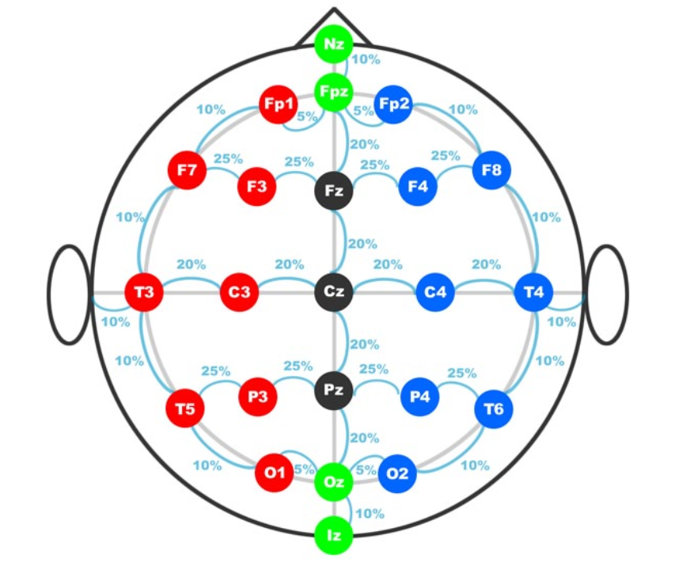
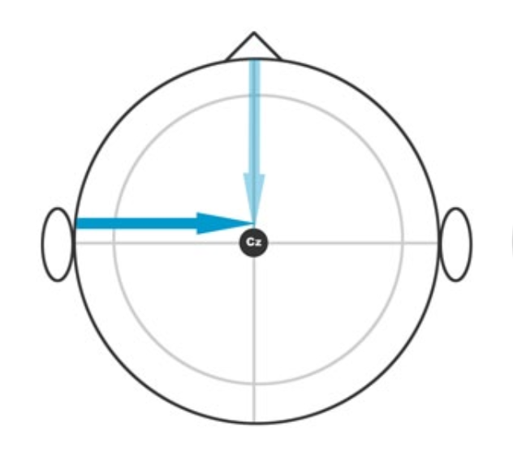
Let’s Get Mapping
Even numbers on the right
Odd numbers on the left
Find CZ
Measure from Nasion to Inion
Mark 50% between N and I
Measure from left preauricular point(LPA) to right preauricular point(RPA)
Mark 50% between LPP and RPP
Where the two meet is CZ
Notes:
How are “WE” going to do this, today?
For the sake of brevity and getting to the good stuff, we will show you how to map of few of the commonly used electrode placements.
Using cm side of measuring tape

Slide 19
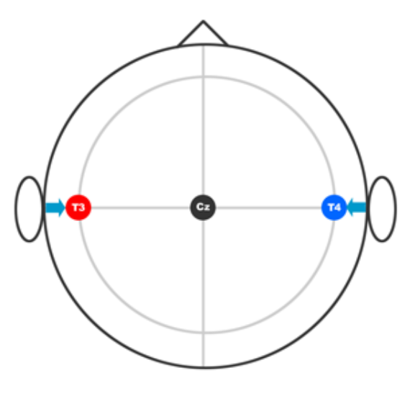
Now Let’s Find T3 and T4
Insightfulness
10% up from RPP is T4
10% up from LPP is T3

Slide 20
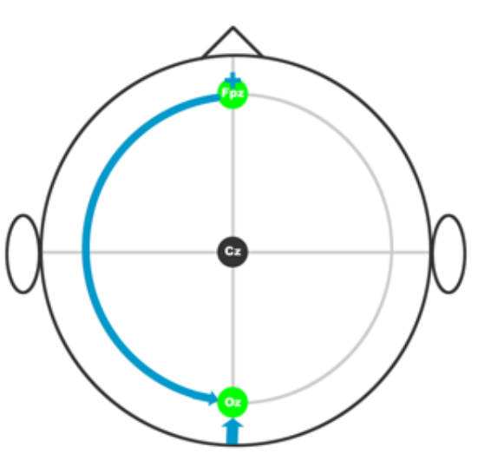
Finding Your Circumference
-Find Fpz and Oz
Preliminary Fpz - 10% up from nasion
Preliminary Oz - 10% up from inion
Measure around head from Fpz to Oz (Through T3 or T4)
measure whole head from Fpz (through Oz) to Fpz and divide by 2 - this is the distance to mark true Fpz and Oz

Slide 21
Mapping the Rest
Remember 10% and 20% Distance
http://chgd.umich.edu/wp-content/uploads/2014/06/10-20_system_positioning.pdf
Notes:
Measurement methods for placement of the F3, F4, P3, and P4 points differ. If measured front-to-back (Fp1-F3-C3-P3-O1 and Fp2-F4-C4-P4-O2 montages), they can be 25% "up" from the front and back points (Fp1, Fp2, O1, and O2). If measured side-to-side (F7-F3-Fz-F4-F8 and T5-P3-Pz-P4-T6 montages), they can be 25% "up" from the side points (F7, F8, T5, and T6). If measured diagonally, from Nasion to Inion through the C3 and C4 points, they will be 20% in front of and behind the C3 and C4 points. Each of these measurement methods results in different nominal electrode placements.

Slide 22
Common Locations for tDCS
Anode F3
Depression, SAD - seasonal affective disorder, Generalized anxiety disorder
Cathode FP2 (right center forehead)
Addiction
Cathode F4 (opposite F3)
Anode Fp1
Attention
Cathode left center forehead or right shoulder
Anode T4 (10% up from Right preauricular point), T3 (10% up from Left Preauricular point)
Notes:
These are 2 inch electrodes, accuracy is a little (slightly/moderately) less important
However...we are scientists...let's be as accurate as possible

Slide 23
Studies Associated with Montages
Some are good, some are bad
Lack of well-structured studies
Must be reproducible
Many studies have failed in replicating results
Actively researched in the medical community
May not be research in areas you have interest
Be a good researcher
Use the scientific method when creating your experiments
Pick a study and see if you can replicate (or disprove) the results
Notes:
This is not a metastudy on montages
Recommendation - follow studies and see if you can replicate results
Many studies that look at the cognitive enhancement benefits of tDCS are poorly designed and lack proper blinding and control conditions.
Add to the body of knowledge

Slide 24
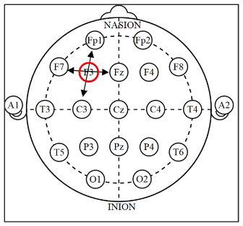
Finding F3
Measure Fp1 to C3 and mark midpoint
Measure Fz to F7 and mark midpoint
Mark 50%
This is F3
https://www.ers-education.org/lrmedia/2016/pdf/298830.pdf

Slide 25
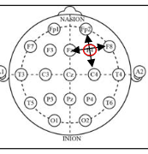
Finding F4
Measure Fp2 to C4 and mark midpoint
Measure Fz to F8 and mark midpoint
Mark 50%
This is F4
https://www.ers-education.org/lrmedia/2016/pdf/298830.pdf

Slide 26
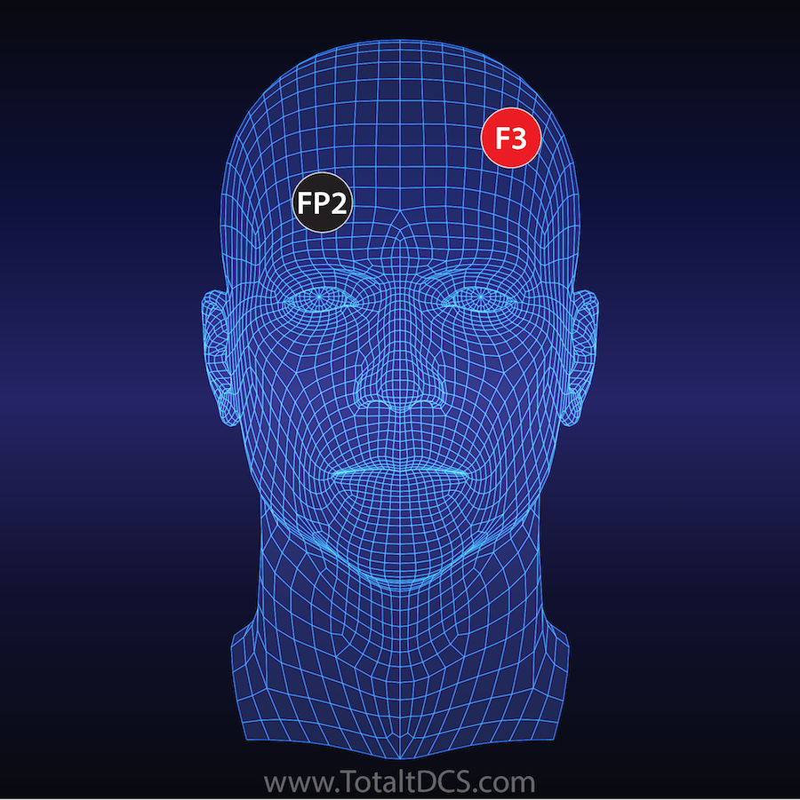
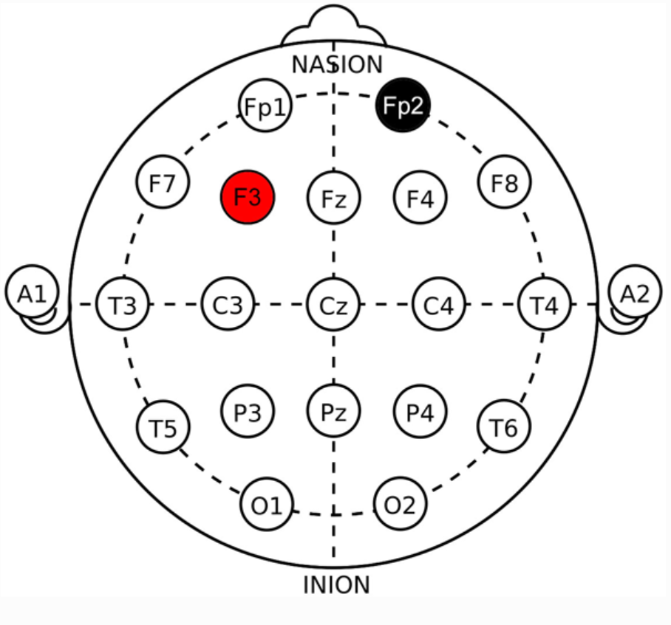
Depression
Go-no-go task performance improvement after anodal transcranial DC stimulation of the left dorsolateral prefrontal cortex in major depression. Boggio PS (2007)
https://www.ncbi.nlm.nih.gov/pubmed/17166593
tDCS over the left prefrontal cortex enhances cognitive control for positive affective stimuli. Vanderhasselt MA (2013)
https://www.ncbi.nlm.nih.gov/pubmed/23704874
https://totaltdcs.com/tdcs-electrode-placement-montage-guide-2/depression-and-anxiety/
Notes:
Typical stimulation protocols are 1-2 mA for 20 minutes over the left DLPFC.
The left DLPFC activity is associated with positive emotional processing.

Slide 27
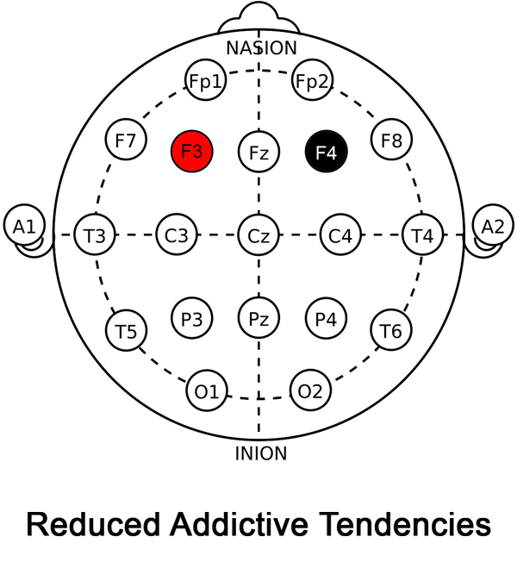
Addiction
Anode: F3 (Left DLPFC)
Cathode: F4 (Right DLPFC)
Notes:
Typical stimulation protocol is 2 mA intensity for 20 minutes.
Can potentially be used to reduce addictive behaviors that include cravings for tobacco, food, alcohol and drugs. Can potentially also be used for reducing risk taking behavior.

Slide 28
Addiction Studies with tDCS
Cumulative priming effects of cortical stimulation on smoking cue-induced craving. Paulo Sergio Boggio (2009)
https://www.sciencedirect.com/science/article/abs/pii/S0304394009009793
A randomized controlled trial of targeted prefrontal cortex modulation with tDCS in patients with alcohol dependence. Jaisa Klauss (2014)
https://academic.oup.com/ijnp/article/17/11/1793/2910056
Transcranial direct current stimulation of the prefrontal cortex modulates the desire for specific foods. Felipe Fregni (2013)
https://www.ncbi.nlm.nih.gov/pmc/articles/PMC3541023/
Prefrontal cortex transcranial direct current stimulation (tDCS) temporarily reduces food cravings and increases the self-reported ability to resist food in adults with frequent food craving. Rachel L. Goldman (2011)
Diminishing risk-taking behavior by modulating activity in the prefrontal cortex: A direct current stimulation study. Shirley Fecteau (2007)
Manipulating Executive Function with Transcranial Direct Current Stimulation. David V. Smith (2009)

Slide 29
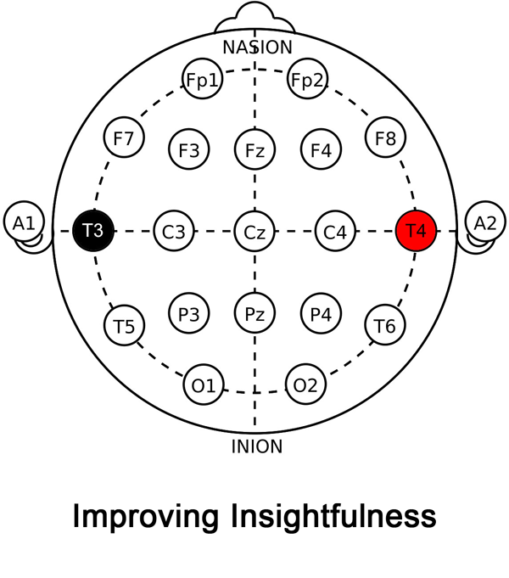
Insightfulness
Anode: T4
Cathode: T3
Brain stimulation enables the solution of an inherently difficult problem. Richard P. Chia and Allan W. Snyder (2012)
https://www.sciencedirect.com/science/article/abs/pii/S0304394012003618
Facilitate Insight by Non-Invasive Brain Stimulation. Richard P. Chi and Allan W. Snyder (2012)
https://journals.plos.org/plosone/article?id=10.1371/journal.pone.0016655
Notes:
Right lateralized tDCS at a max current output 1.6 mA was found to increase the user's ability to solve difficult problems; suggesting this montage may have played a role in mitigating cognitive biases that impede higher creative thinking. 40% of participants were able to find the solution to a difficult problem after receiving right lateralized tDCS, whereas none of the participants were able to solve it beforehand.
The general understanding so far for this montage is that mental templates and/or cognitive biases may be weakened which is associated with users increasing their insightfulness and ability to find novel meaning in a given set of information.

Slide 30
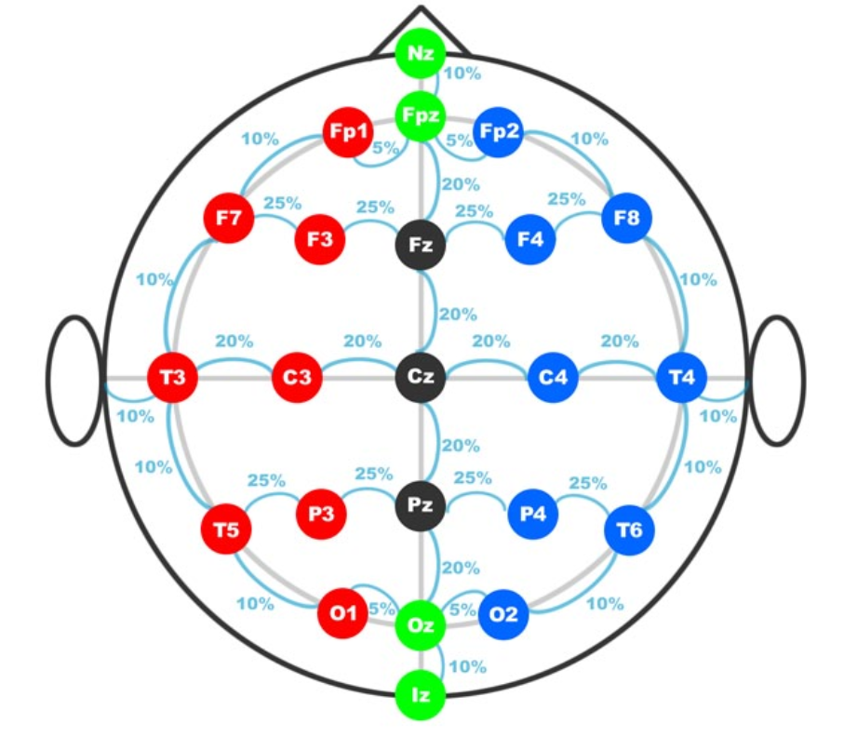
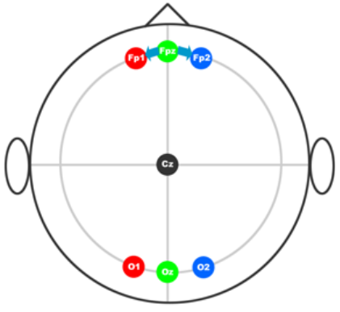
Attention Improvement
Fp1 or Fp2 (Anode)
Opposite shoulder (cathode)
Notes:
Measure and mark 5% of total circumference to the left and right of Fpz. These will be your true Fp1 and Fp2 marks.

Slide 31
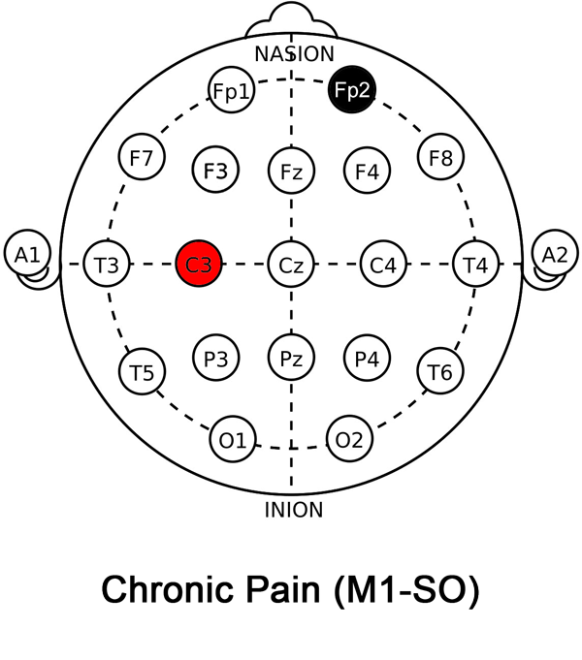
Chronic Pain/Fibromyalgia
Anode C3
Cathode (Fp2)
https://www.ncbi.nlm.nih.gov/pubmed/?term=Ipsilesional+anodal+tDCS+enhances+the+functional+benefits+of+rehabilitation+in+patients+after+stroke

Slide 32
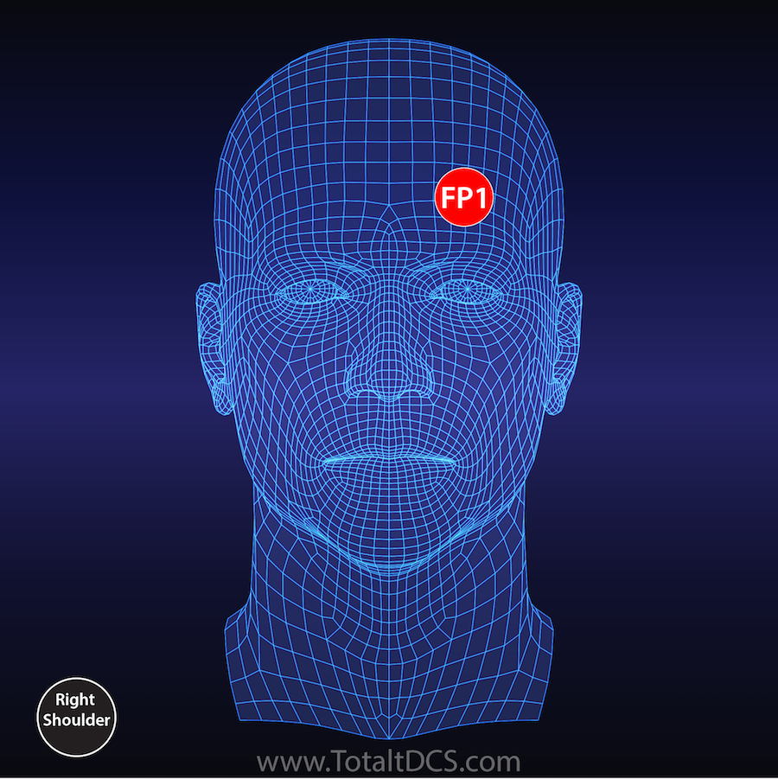
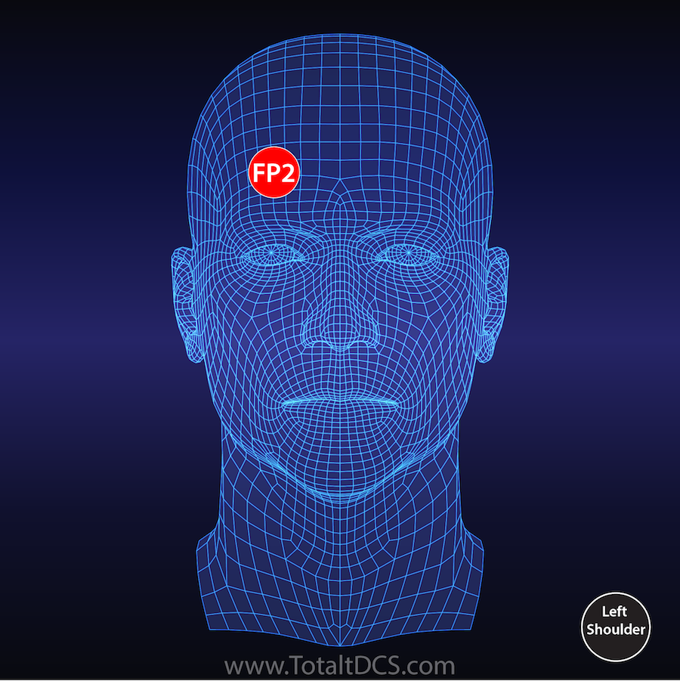
ADHD
Fz (anode)
Left cheek (cathode)
“Modal stimulation over the Fz position (associated with the pre-supplementary motor area) was found to improve the efficiency of inhibitory control, thereby improving symptoms of attention-deficit hyperactivity disorder (ADHD).
Modulating inhibitory control with direct current stimulation of the superior medial frontal cortex. Tzu-Yu Hsu (2011)
http://icn.ncu.edu.tw/upload/paper/20130207035040Neil_2011_Modulating%20inhibitory%20control%20with%20direct%20current%20stimulation%20of%20the%20superior%20medial%20frontal%20cortex..pdf
https://www.tdcs.com/montage-guide

Slide 33
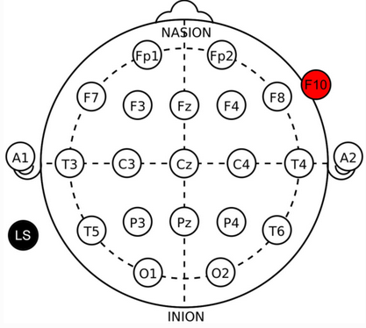
Improved Cognition
DARPA Montage
Controversy

Slide 34
Other Montages
https://www.tdcs.com/montage-guide
https://www.reddit.com/r/tDCS/comments/2e7idx/simple_montage_list_with_electrode_placement_and/
https://totaltdcs.com/
https://cdn.shopify.com/s/files/1/3104/9196/files/tDCS_montage_reference_v1_0.pdf?923975672558430024

Slide 35
Setting up Your Session
Choose a Protocol
Amplitude
Duration
Montage
Create saline (conductivity solution)
Are you going to evaluate your results?
Notes:
Montage is electrode placement
What is a protocol? What is the approach?
1.5mA to 2.0mA – 20 minutes
1/8 teaspoon per cup (distilled – maybe boiled and cooled water) – future studies coming

Slide 36
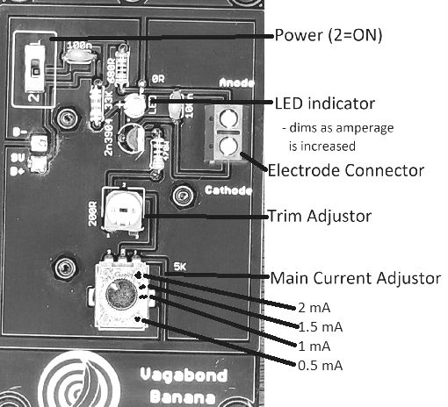
Badge Overview
Calibration
Operation
Saline solution

Slide 37
Another Disclaimer
The tDCS device provided in this workshop is not intended as a medical device and is not approved by the FDA. The user accepts all risk associated with the advice, guidance, claims, and references provided within this presentation.
By accepting this tDCS device, you are accepting all risk associated with its ownership and usage.
Children, elderly, and people with history of epilepsy, stroke, or implants should consider avoiding DIY tDCS.
Please consult your physician before engaging in DIY tDCS
BY ACCEPTING AND/OR USING THIS DEVICE, YOU ACCEPT ALL RISK, RESPONSIBILITY, AND LIABILITY ASSOCIATED WITH IT

Slide 38
Resources
http://VagabondBanana.com
http://www.quantified-mind.com/
https://www.reddit.com/r/tDCS/
http://chgd.umich.edu/wp-content/uploads/2014/06/10-20_system_positioning.pdf

Slide 39
Acknowledgements
Thank you to:
The BioHacking Village for supporting this workshop
OSHPark for assisting in the prototyping and printing of this PCB
Kulty for the initial design of an affordable tDCS device
Vasileios Mingos for the board layout and final design collaboration
YOU for being here!

Slide 40
Let’s Get Grooving
Badge handout

Slide 41
Cognitive Function tDCS Efficacy Test

Slide 42
Words 2
cape | creep | enemy
package | green | pick
ball | locality | wrist
landlord | person | treat
donkey | belief | moderate

Slide 43
Write What you Remember

Slide 44
Now How Did You Do?
cape | creep | enemy
package | green | pick
ball | locality | wrist
landlord | person | treat
donkey | belief | moderate
Notes:
Did your score change in any way?

Slide 45
Thank You!

